Slide 1

XGBoost Regressor

Slide 2
Definition:
XGBoost Regressor is a machine learning algorithm used for regression tasks. It is an implementation of gradient boosted decision trees designed for speed and performance.

Slide 3
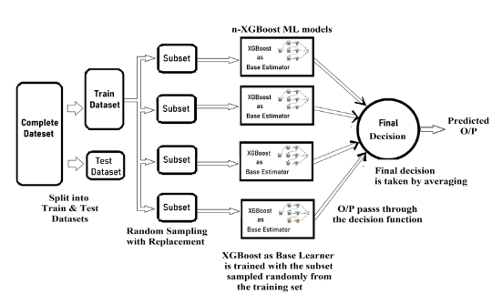
Image Representation

Slide 4
Working Principle:
Initialization: Each data point is given equal weight.
Training:
A base learner (usually a decision tree) is trained on the dataset.
It focuses more on data points with higher weights.
Errors are noted, and subsequent learners are trained to correct these errors.
Boosting:
Each new learner is trained to minimize the error of the whole ensemble.
Learners are added sequentially until no further improvements can be made.
Combination:
Combine the predictions of all weak learners, weighted by their performance.
Generate the final prediction.

Slide 5
Advantages:
High Accuracy: XGBoost can achieve high accuracy by iteratively improving weak learners.
Regularization: Built-in regularization techniques help prevent overfitting.
Flexibility: Supports custom optimization objectives and evaluation metrics.
Disadvantages:
Complexity: XGBoost has many hyperparameters to tune, which can make it complex.
Computationally Intensive: Training XGBoost models can be computationally expensive, especially for large datasets.
Requires Tuning: Parameters like learning rate, tree depth, and regularization parameters need to be tuned for optimal performance.

Slide 6
import xgboost as xgb
model = xgb.XGBRegressor(objective ='reg:squarederror’)
he XGBRegressor class in the XGBoost library is used to create an XGBoost ensemble for regression tasks. Here's a brief overview:
objective: The learning objective. For regression tasks, 'reg
' (mean squared error) is commonly used.

Slide 7
Applications:
Stock Market Prediction: Predicting stock prices based on historical data.
Housing Price Prediction: Forecasting housing prices based on features like location, size, etc.
Customer Lifetime Value Prediction: Estimating the future value of a customer to a business.
Anomaly Detection: Identifying unusual patterns or outliers in data.
XGBoost Regressor is a powerful algorithm known for its performance and flexibility in handling regression tasks. However, careful tuning of hyperparameters is essential for optimal results.

